Slide 1

Training Workshop
Session 5: Material &
Section Properties

Slide 2
ABAQUS Tutorial
Dynamic &
Contact FEA
Postprocessing
ABAQUS
Material &
Section Properties
Job Processing
(Solver)
Loading &
Analysis Steps
Meshing

Slide 3
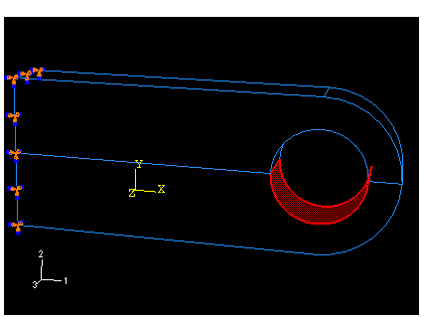
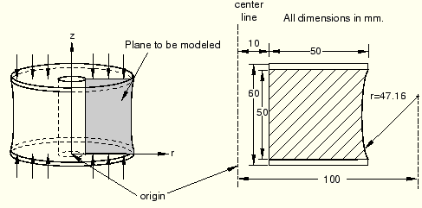
ABAQUS Material
Most commonly used material models:
  linear elasticity
  metal plasticity
  rubber elasticity

Slide 4
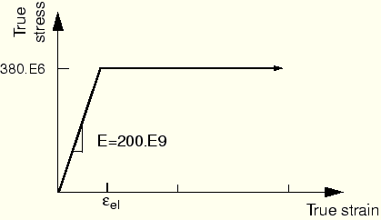
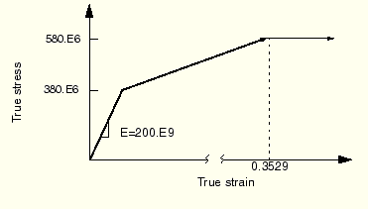
Metal plasticity
Perfect plasticity
Hardening

Slide 5
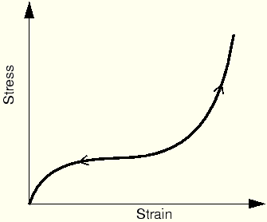
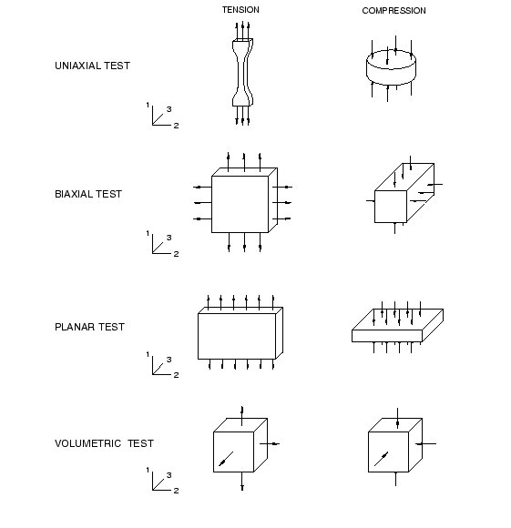
  Rubber elasticity
  Hyperelasticity
Define a hyperelastic material using experimental data
The stress-strain behavior of typical rubber materials is elastic but highly nonlinear.
The deformation remains elastic up to large strain values (often well over 100%).

